Slide 1
Design Challenge 1
Raghav Agarwal, Veeresh Ayyagari, Yubo Cao, Camille Levine, Ziyang Shen
Notes:
Each team will have two of their members present their group’s work.
• Team members should prepare a 10-minute PowerPoint presentation including:
I. “Bridge Design” – How your team came up with 1st iteration bridge concept,
with a SolidWorks rendering of the bridge architecture(s);
II. “Fabrication Considerations” – Discussion of support structure design (with
SolidWorks rendering), rationale for print orientation and infill/shell settings;
III. “Fabrication Results” – Results (with images/video) for 1st iteration: (i) bridge
as-received (bridge+support structures), and (ii) post-processing protocols;
IV. “Experimental Results” – Video of the preliminary 1st iteration bridge testing
(which can be sped up, or cut together if needed), images and discussion of
where the bridge broke (and why you think it broke there) if applicable;
V. Repeat I. through V. for the 2nd iteration (make sure to discuss how your
design/results changed with respect to the 1st iteration test); and
VI. “Lessons Learned” – Discussion of any important differences between your
original CAD designs and the actual 3D printed parts, anything that happened
that you didn’t expect, and future recommendations for design, fabrication,
and/or processing changes (especially relevant to your final results).

Slide 2
Iteration 1

Slide 3
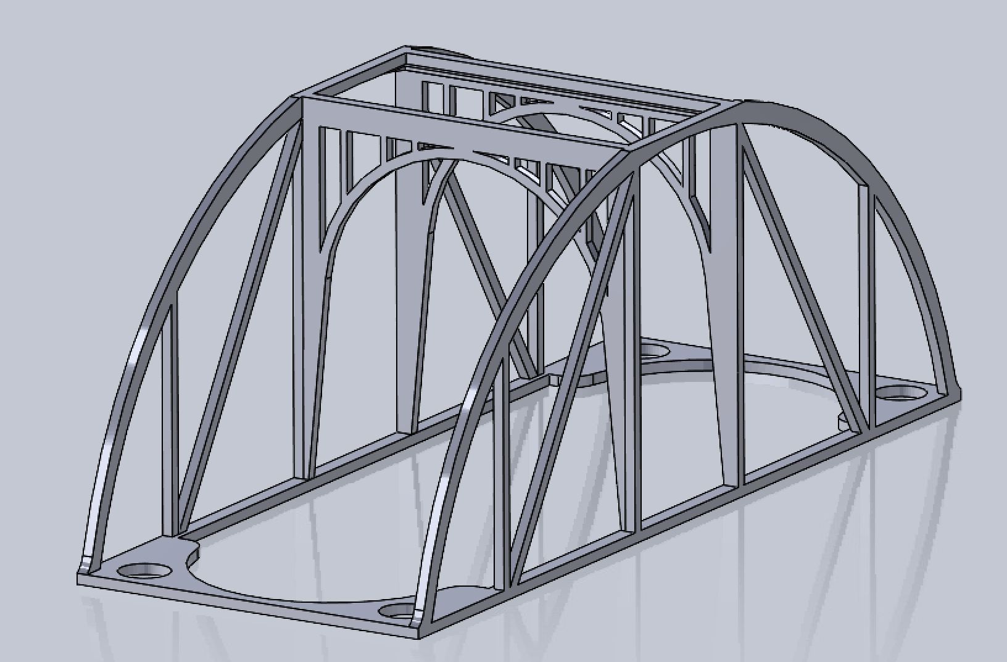
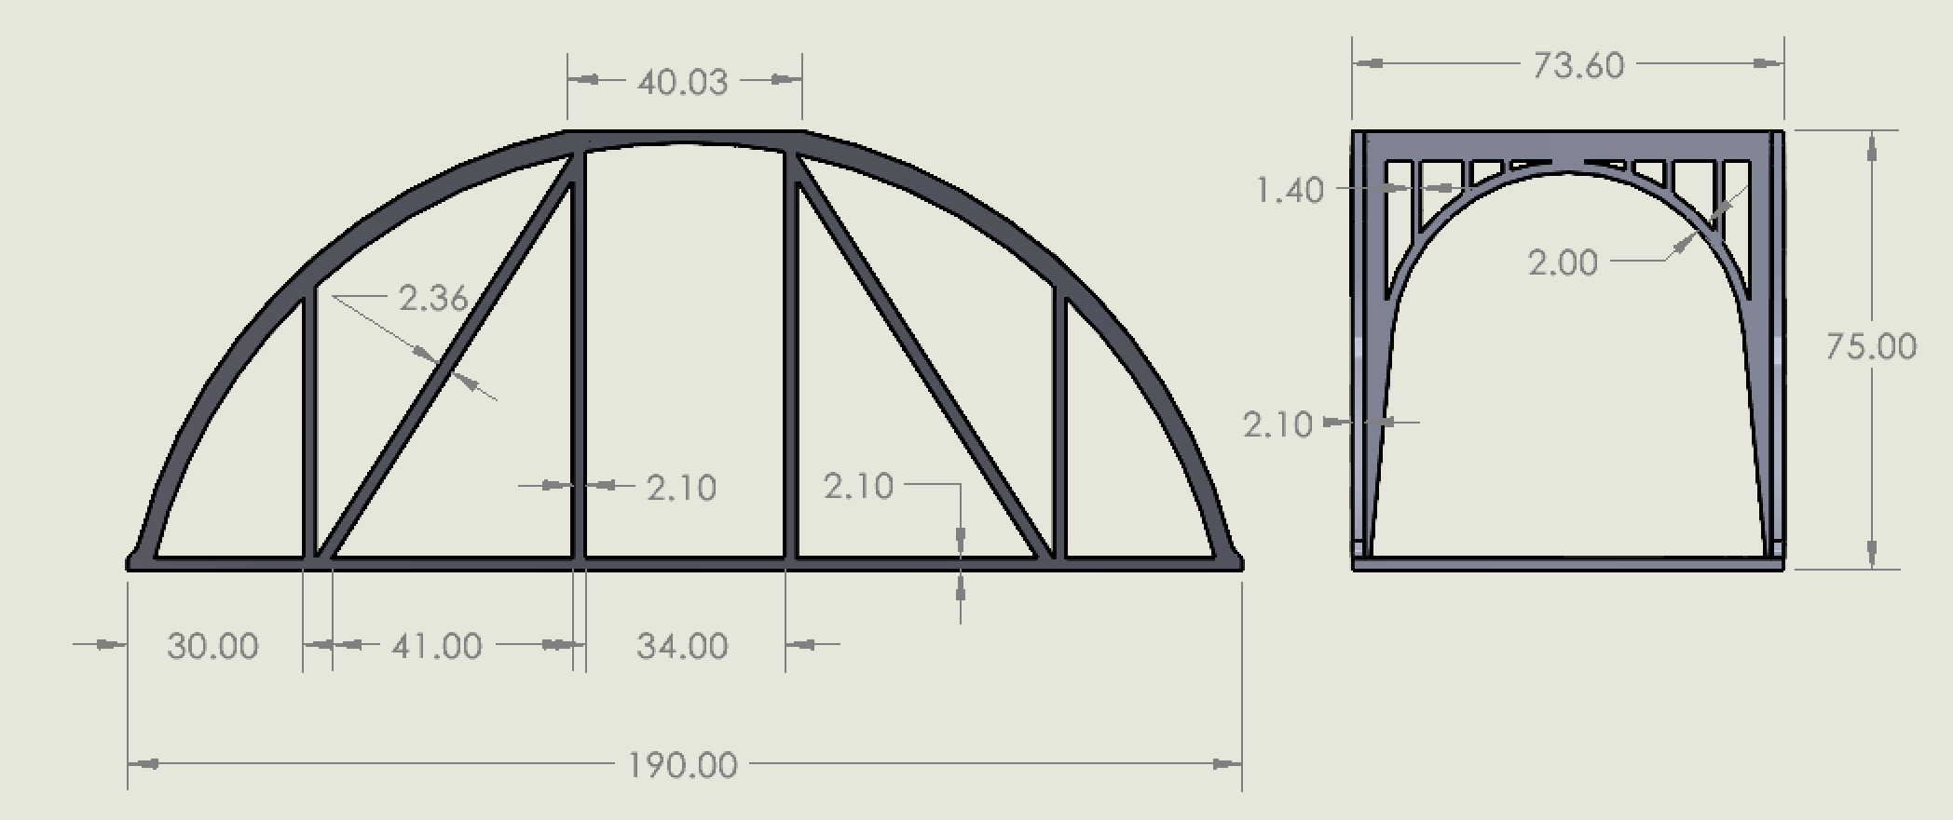



Bridge Design
Iteration 1
Arch design originally inspired by Anzi bridge in China- the oldest standing bridge in the country!
Triangular truss design on either side
Widths of beams: 2.1mm
Total height 75mm
Total width 73.6mm
Total length 190mm
Notes:
We decided to go with an arch bridge since arches are a very strong shape and additive manufacturing lends itself to the geometry- you couldn’t build this with 2x4s. Our original inspiration was the Anzi bridge in China which is one of the longest standing bridges in the world and the longest in China. (click)
As for specifics on the design, we added a triangular truss design to either side and made each beam 2.1mm wide to keep it a multiple of 0.7mm. The total height was 75mm and width was 73.6mm, but the total length was 190mm, which as we’ll see later posed an issue for testing.

Slide 4
Fabrication Considerations
Iteration 1
Supports used were honeycomb structures underneath the central arches and simple rectangular supports under the center of the main arches.

Slide 5
Fabrication Considerations
Iteration 1
Infill settings and print orientation

Slide 6
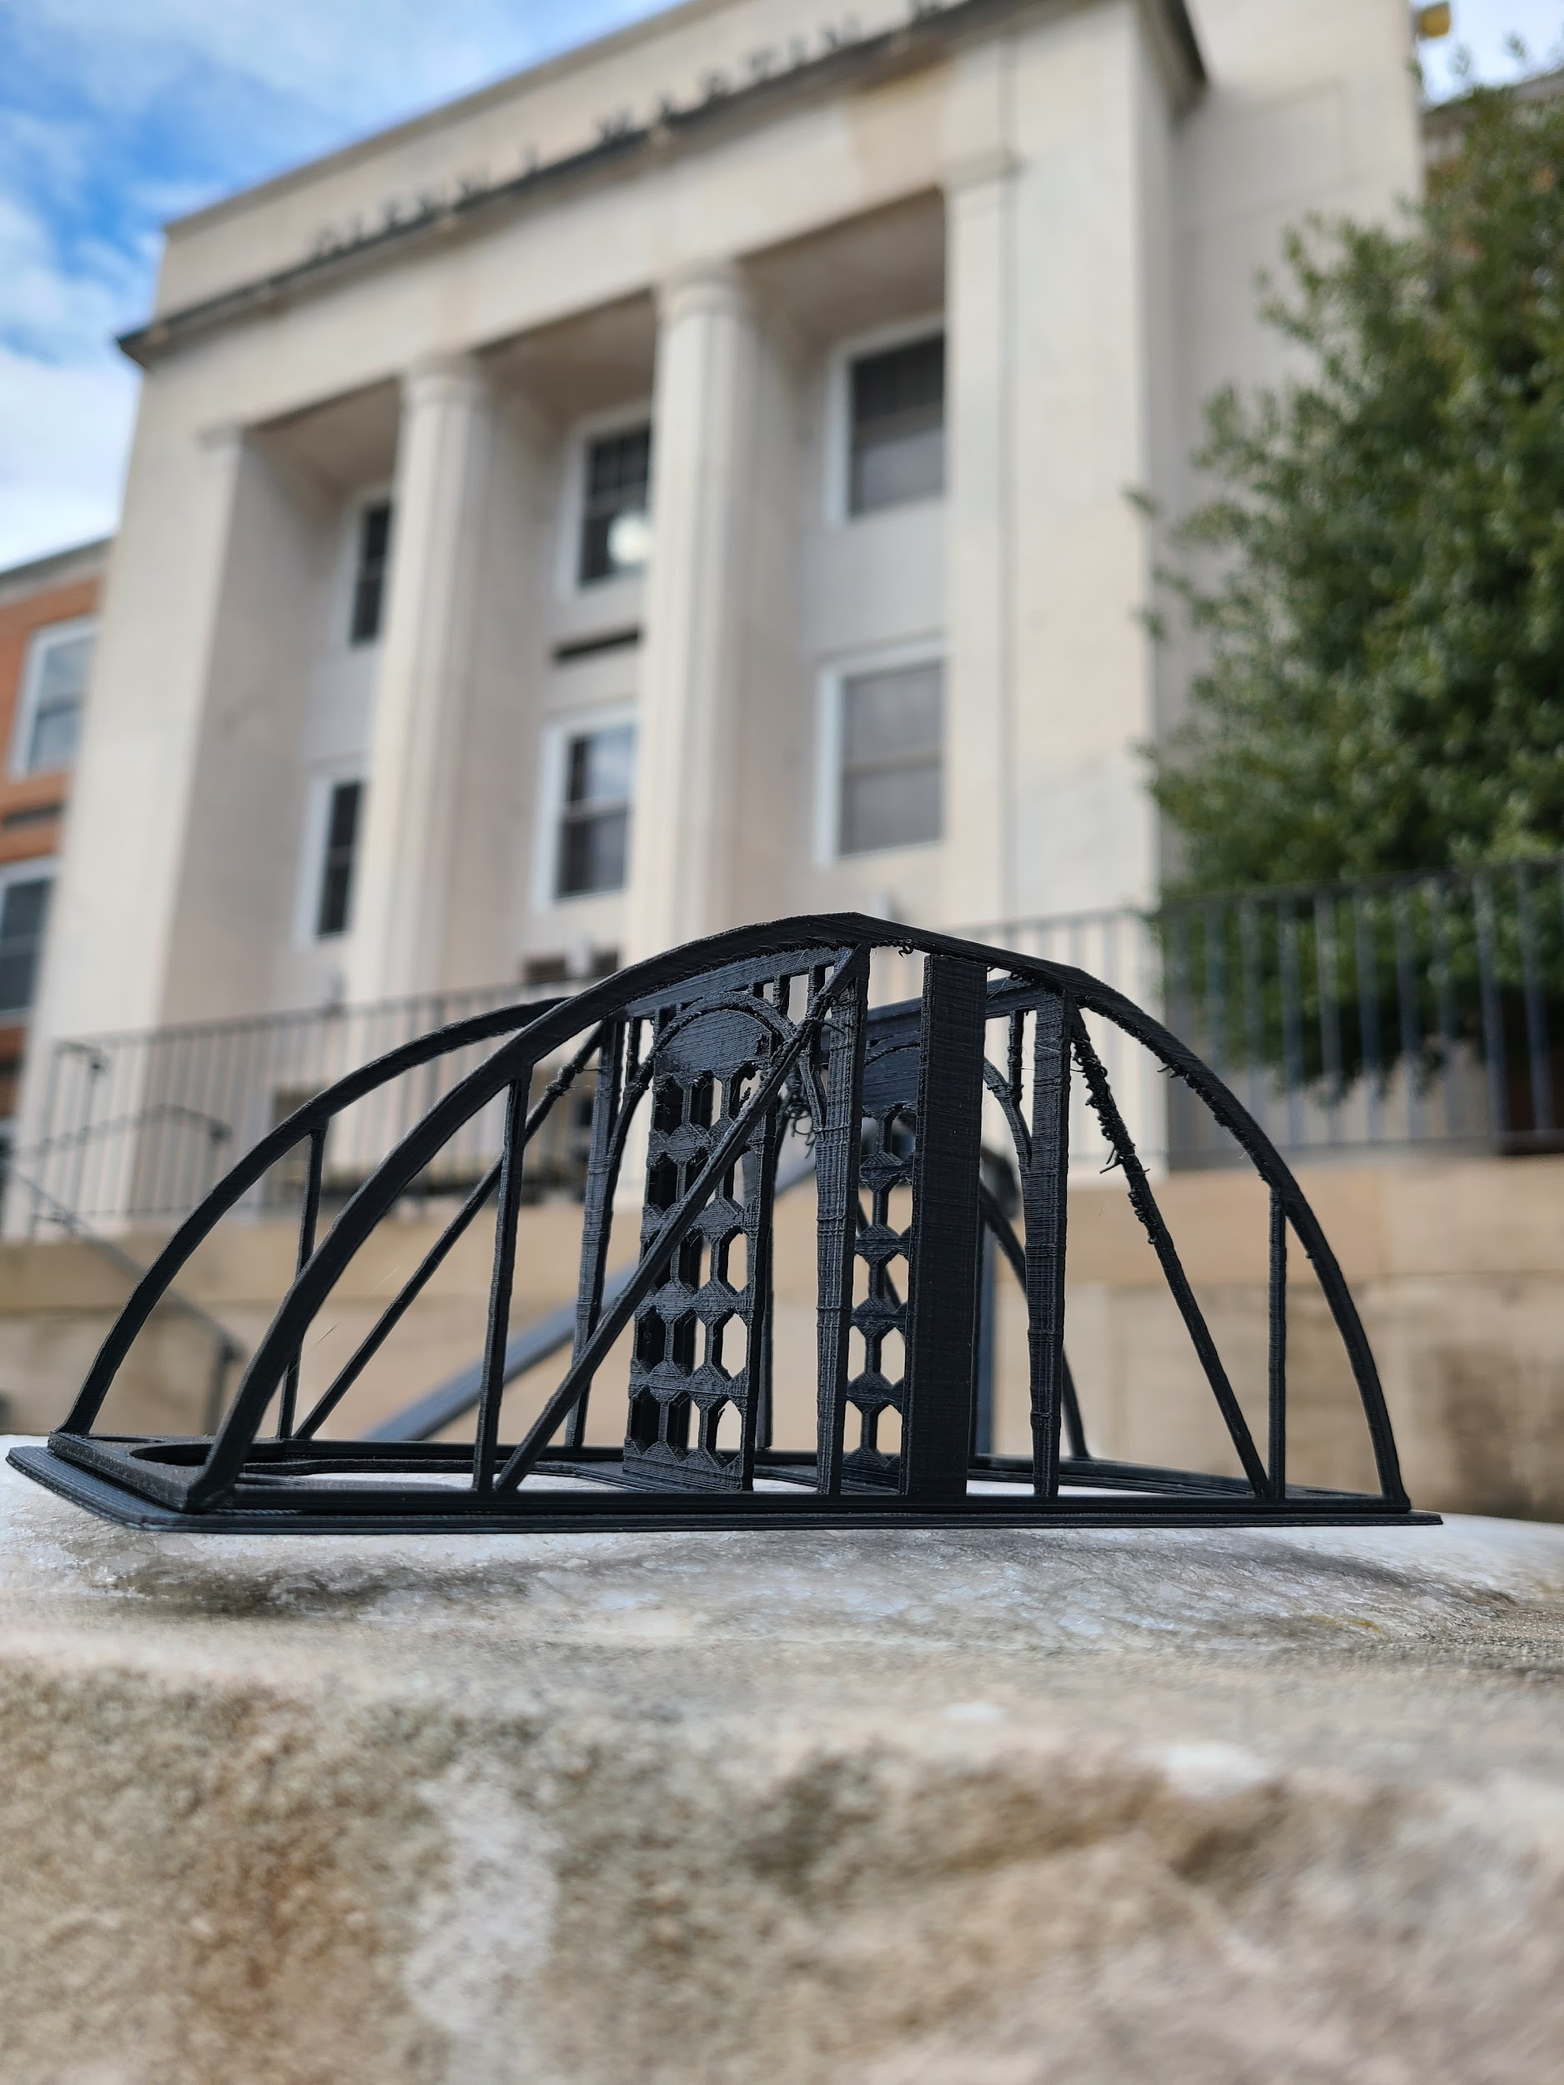
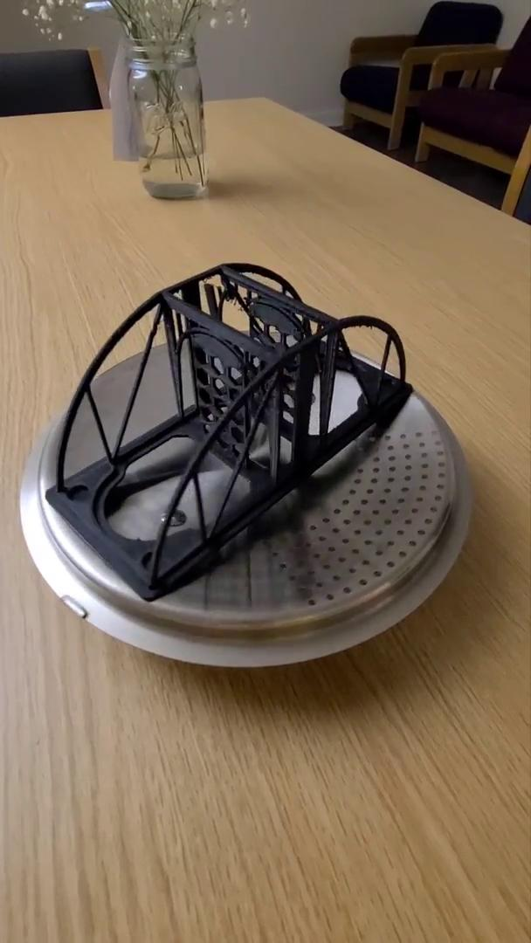
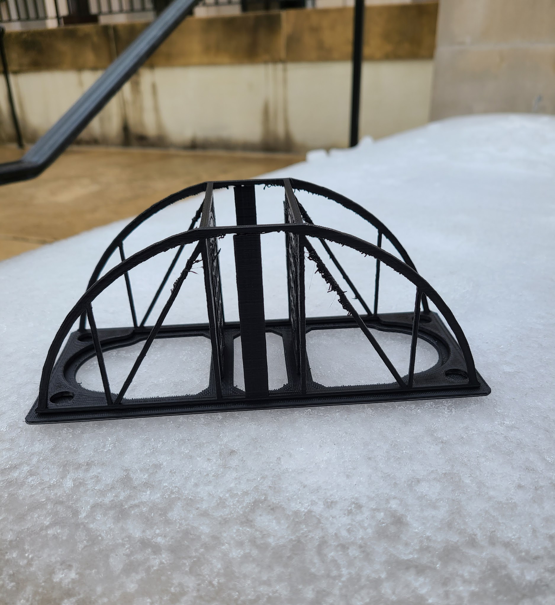
Fabrication Results
Iteration 1
Notes:
Here are some images of how our bridge turned out before support and raft removal, as well as a 3d rotational view of the final product. It looks great at first glance despite some stringing particularly on the diagonal members.

Slide 7
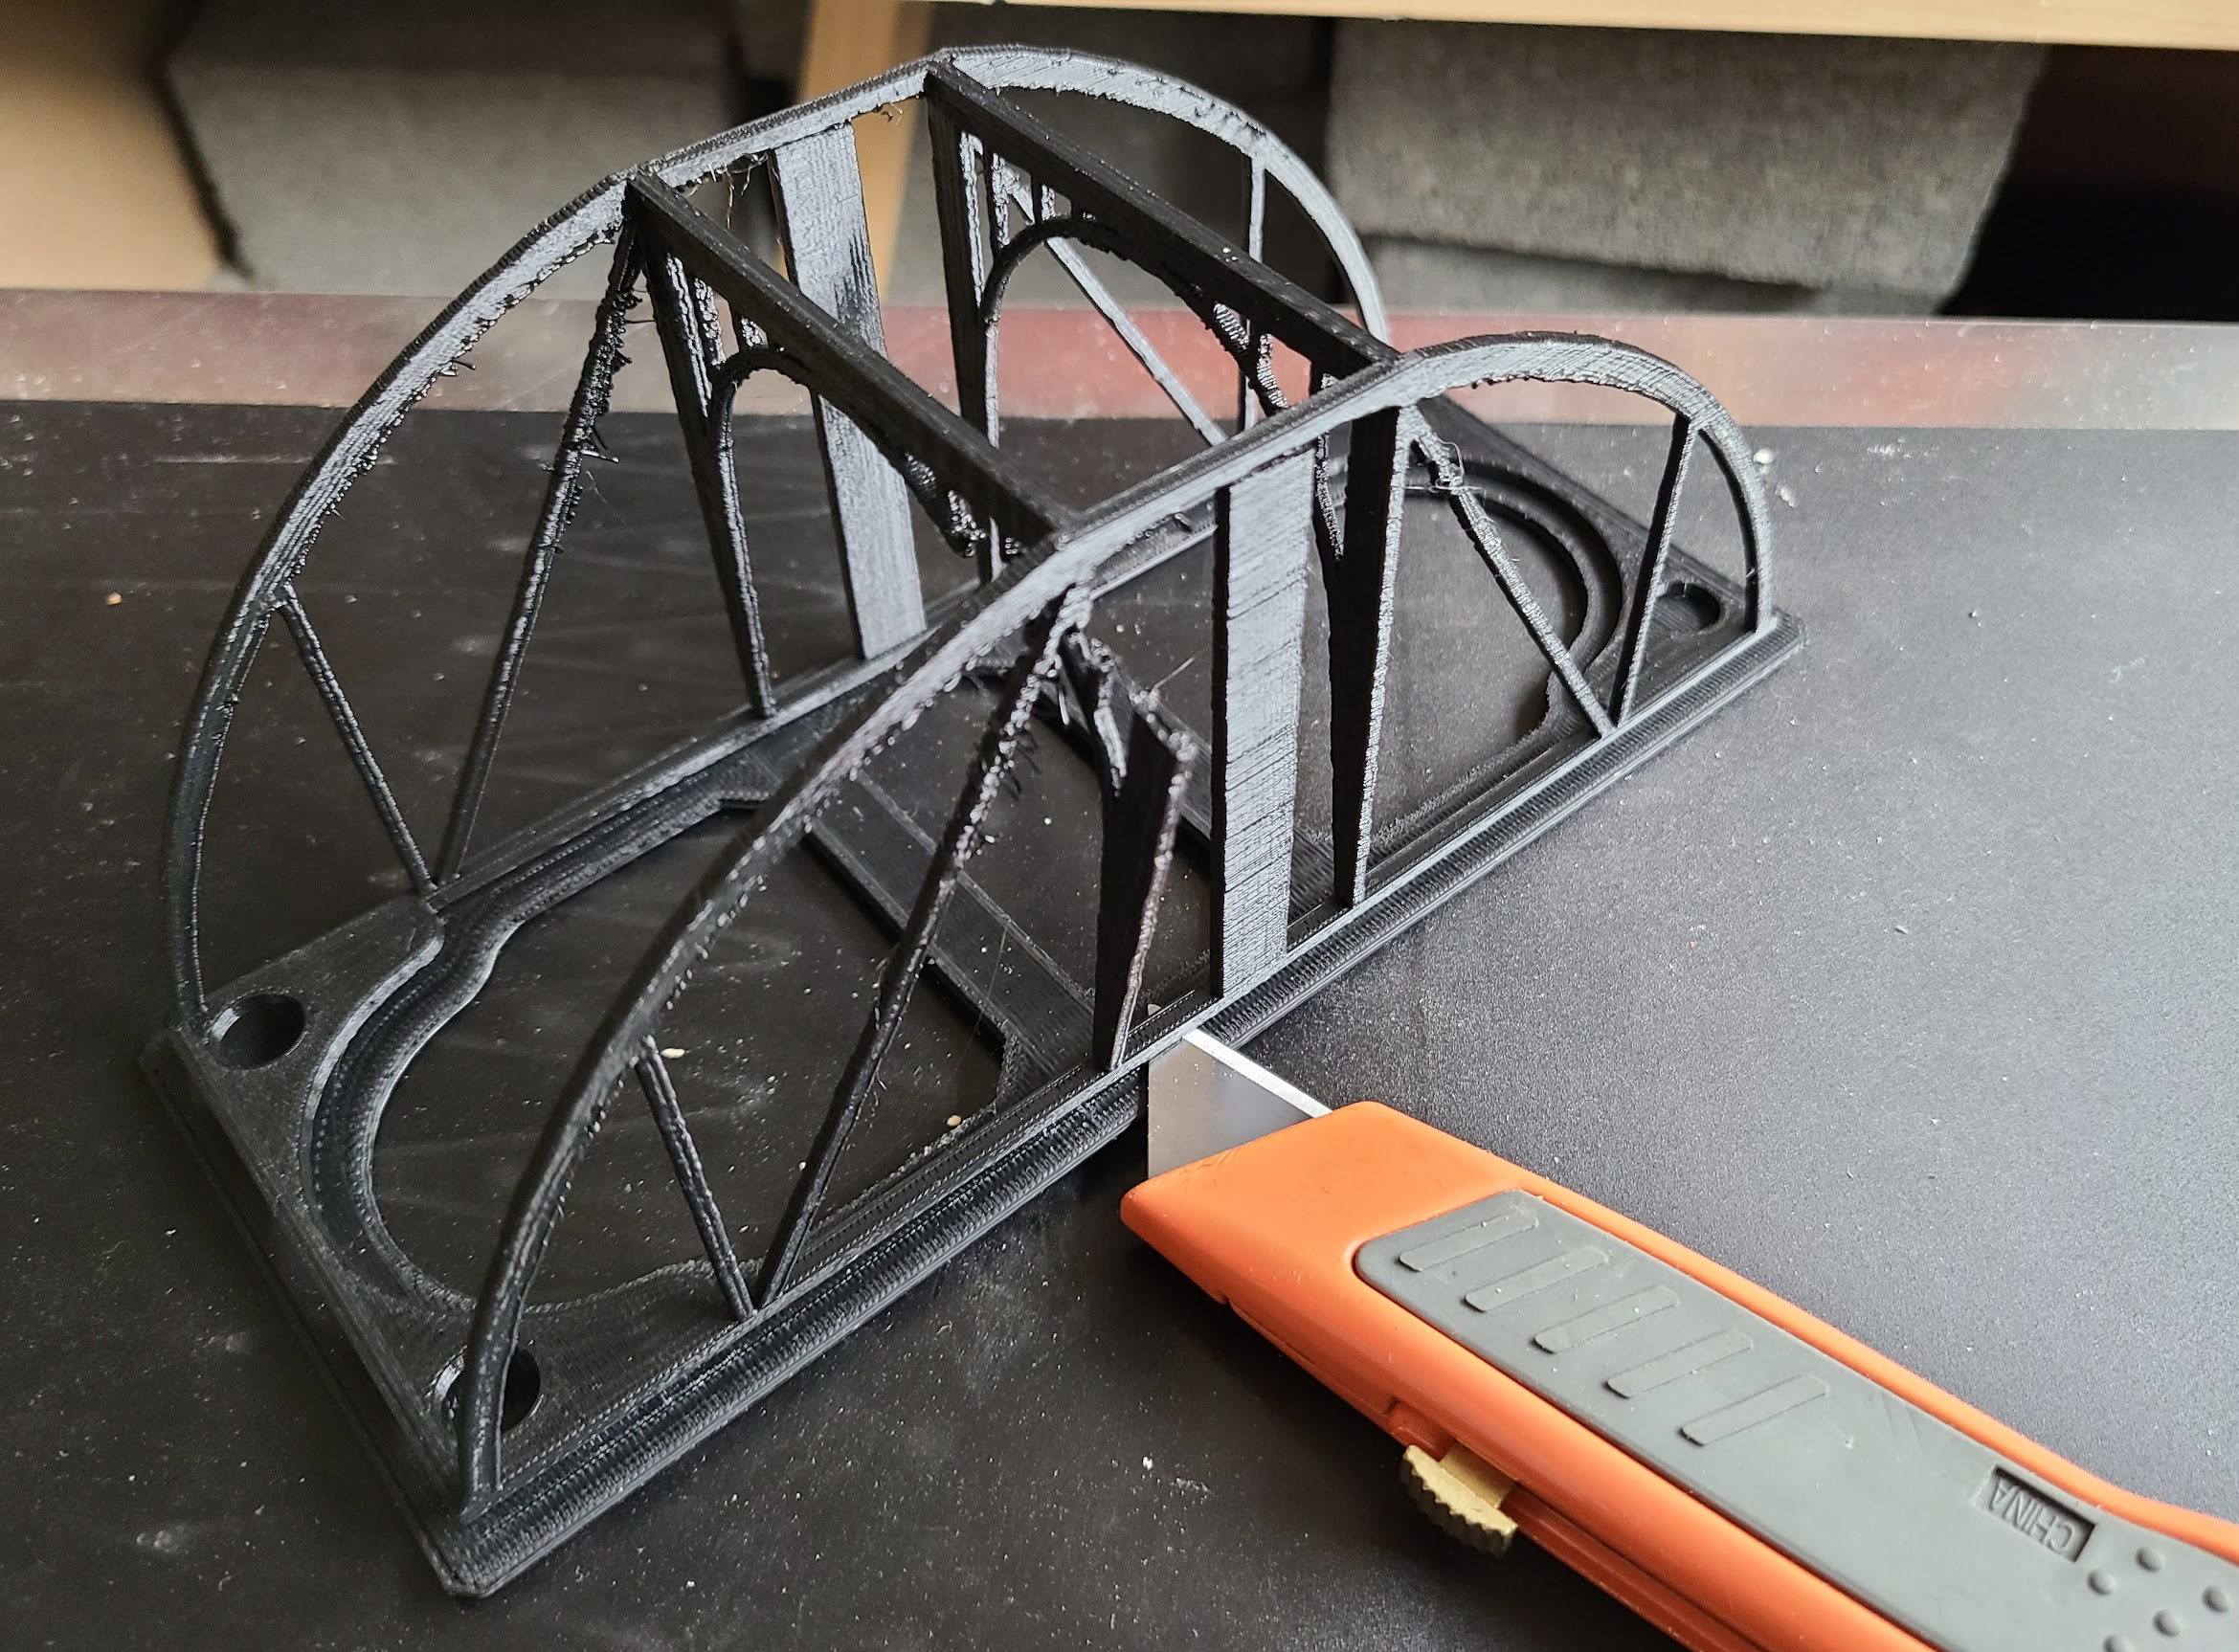
Fabrication Results
Iteration 1
Unfortunately, a print error occurred- solution we chose was to leave side rectangular supports in during testing
Raft support removal was the most difficult part
Remaining rectangular support
Print error
Notes:
One issue with the print is that there was a print error at the support of the interior arch. This seemed like it would pose serious issues with the bridge’s internal integrity, so we made the decision to leave the rectangular supports in place during testing for additional structural support.
Overall, support removal was quite easy for the hexagonal panels, and slightly more difficult for the raft. We had to use box cutters and a lot of care in order to remove the raft without harming the bridge or ourselves.

Slide 8
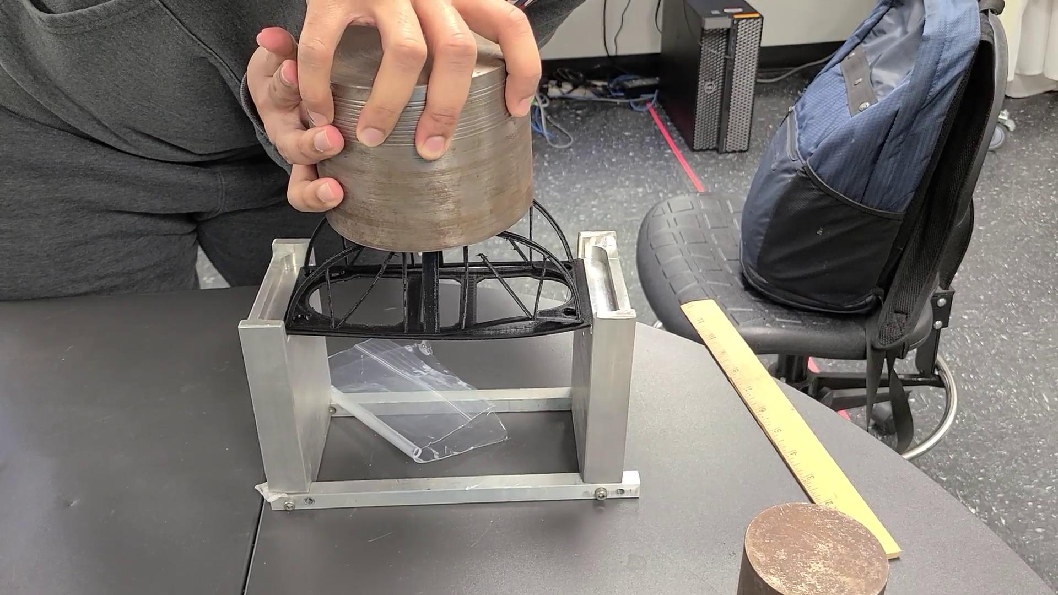
Experimental Results
Iteration 1

Slide 9
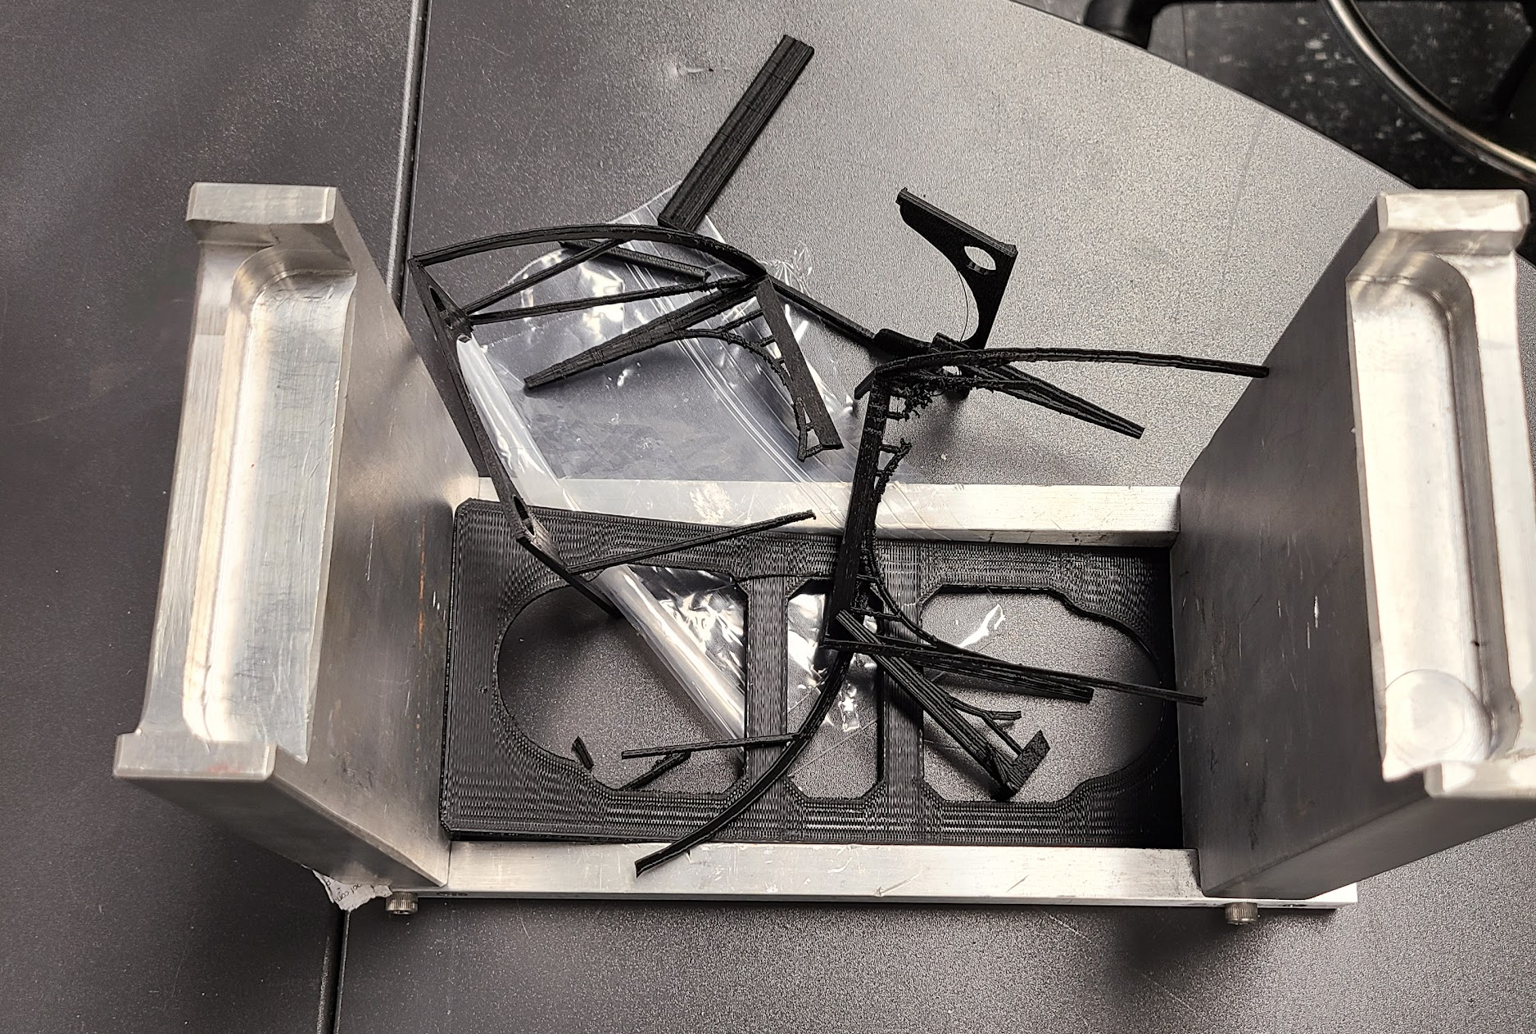
Experimental Results
Iteration 1

Slide 10
Iteration 2

Slide 11
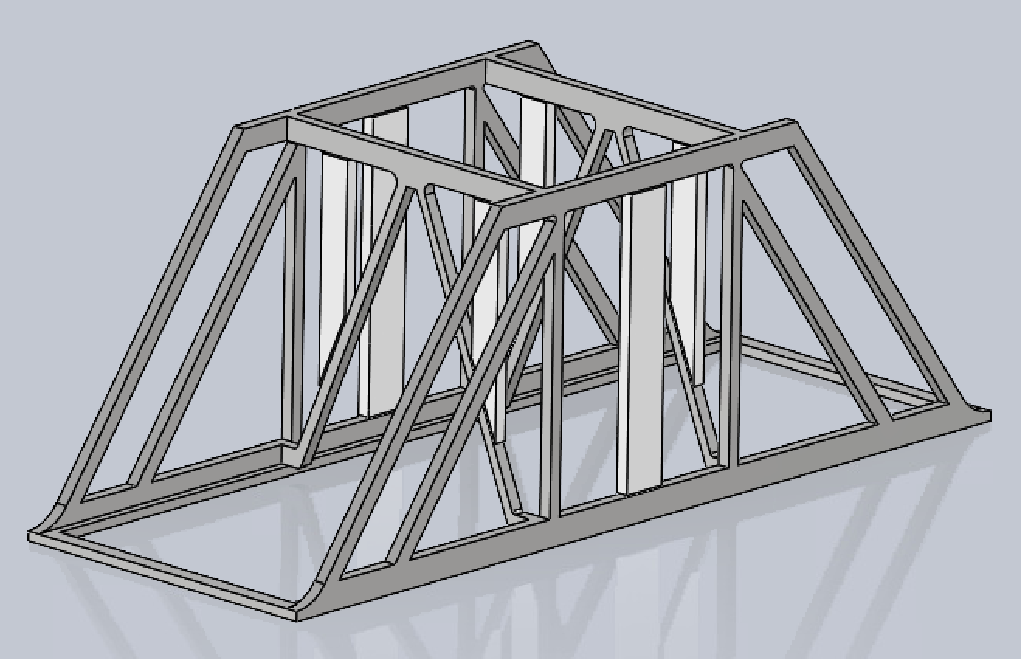
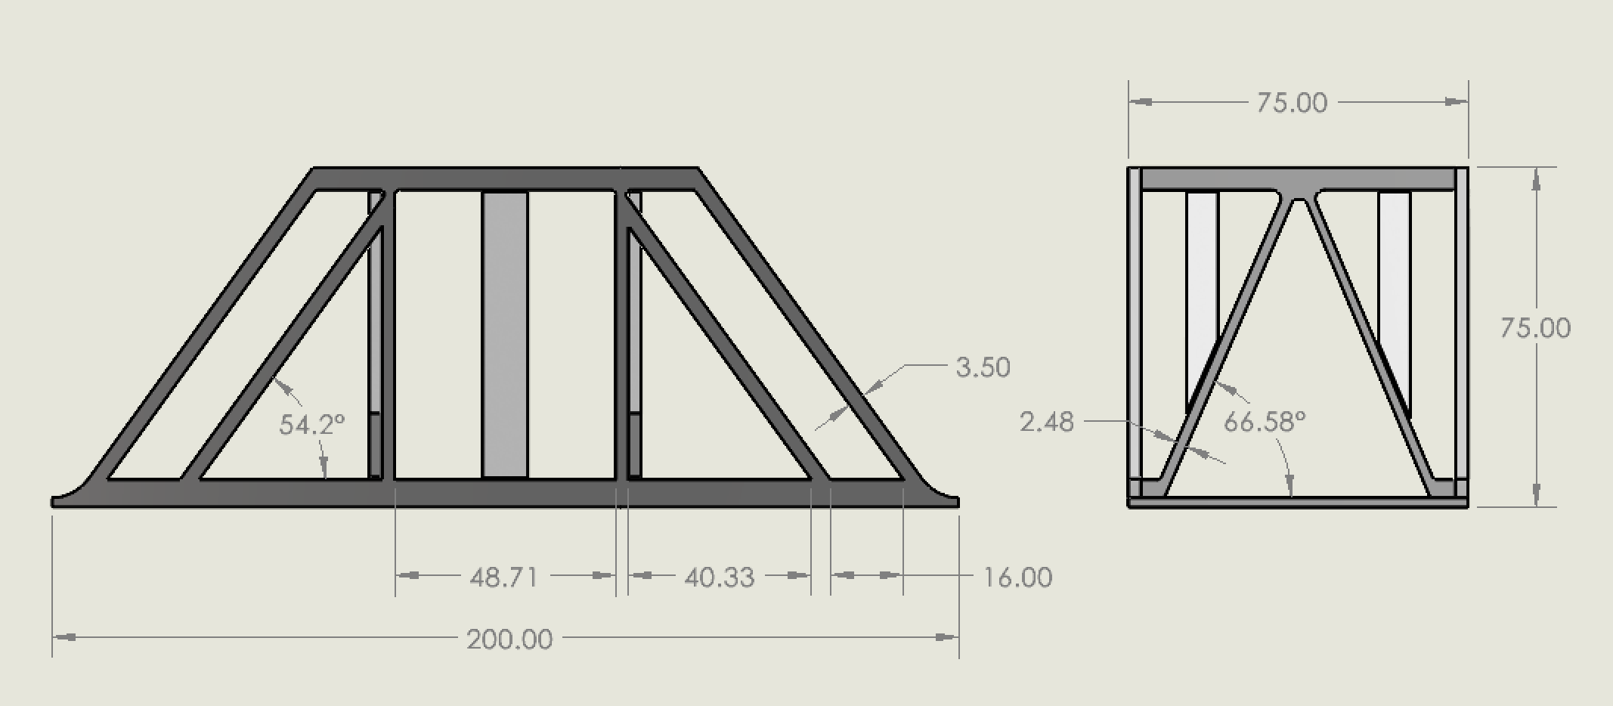
Bridge Design
Iteration 2
Notes:
2.8 mm no infill

Slide 12
Fabrication Considerations
Iteration 2

Slide 13
Fabrication Results
Iteration 2

Slide 14
Experimental Results
Iteration 2

Slide 15
Conclusion

Slide 16
Lessons Learned

Slide 17
Questions?
(bibliography?)

